Slide 1
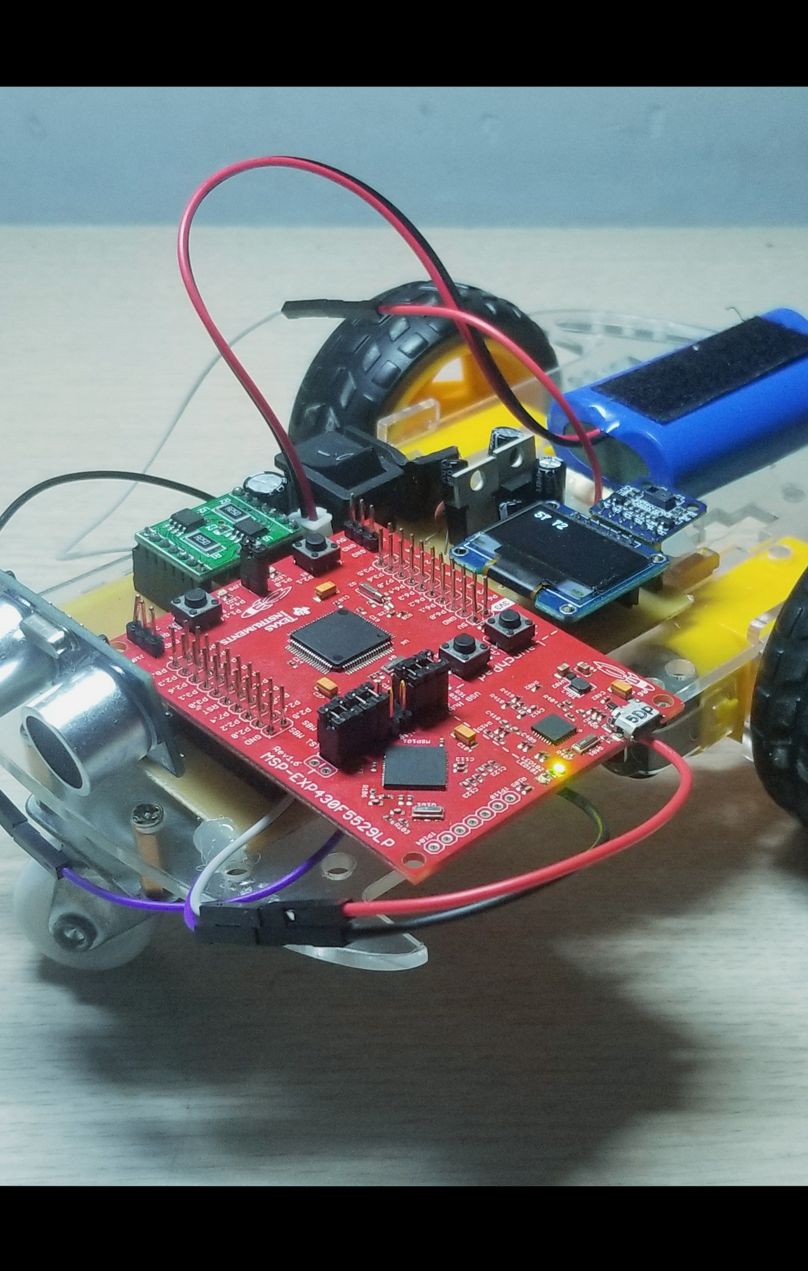
智能小车 课程设计
小组成员：林钧铭 陈飞鸢
57 72

Slide 2
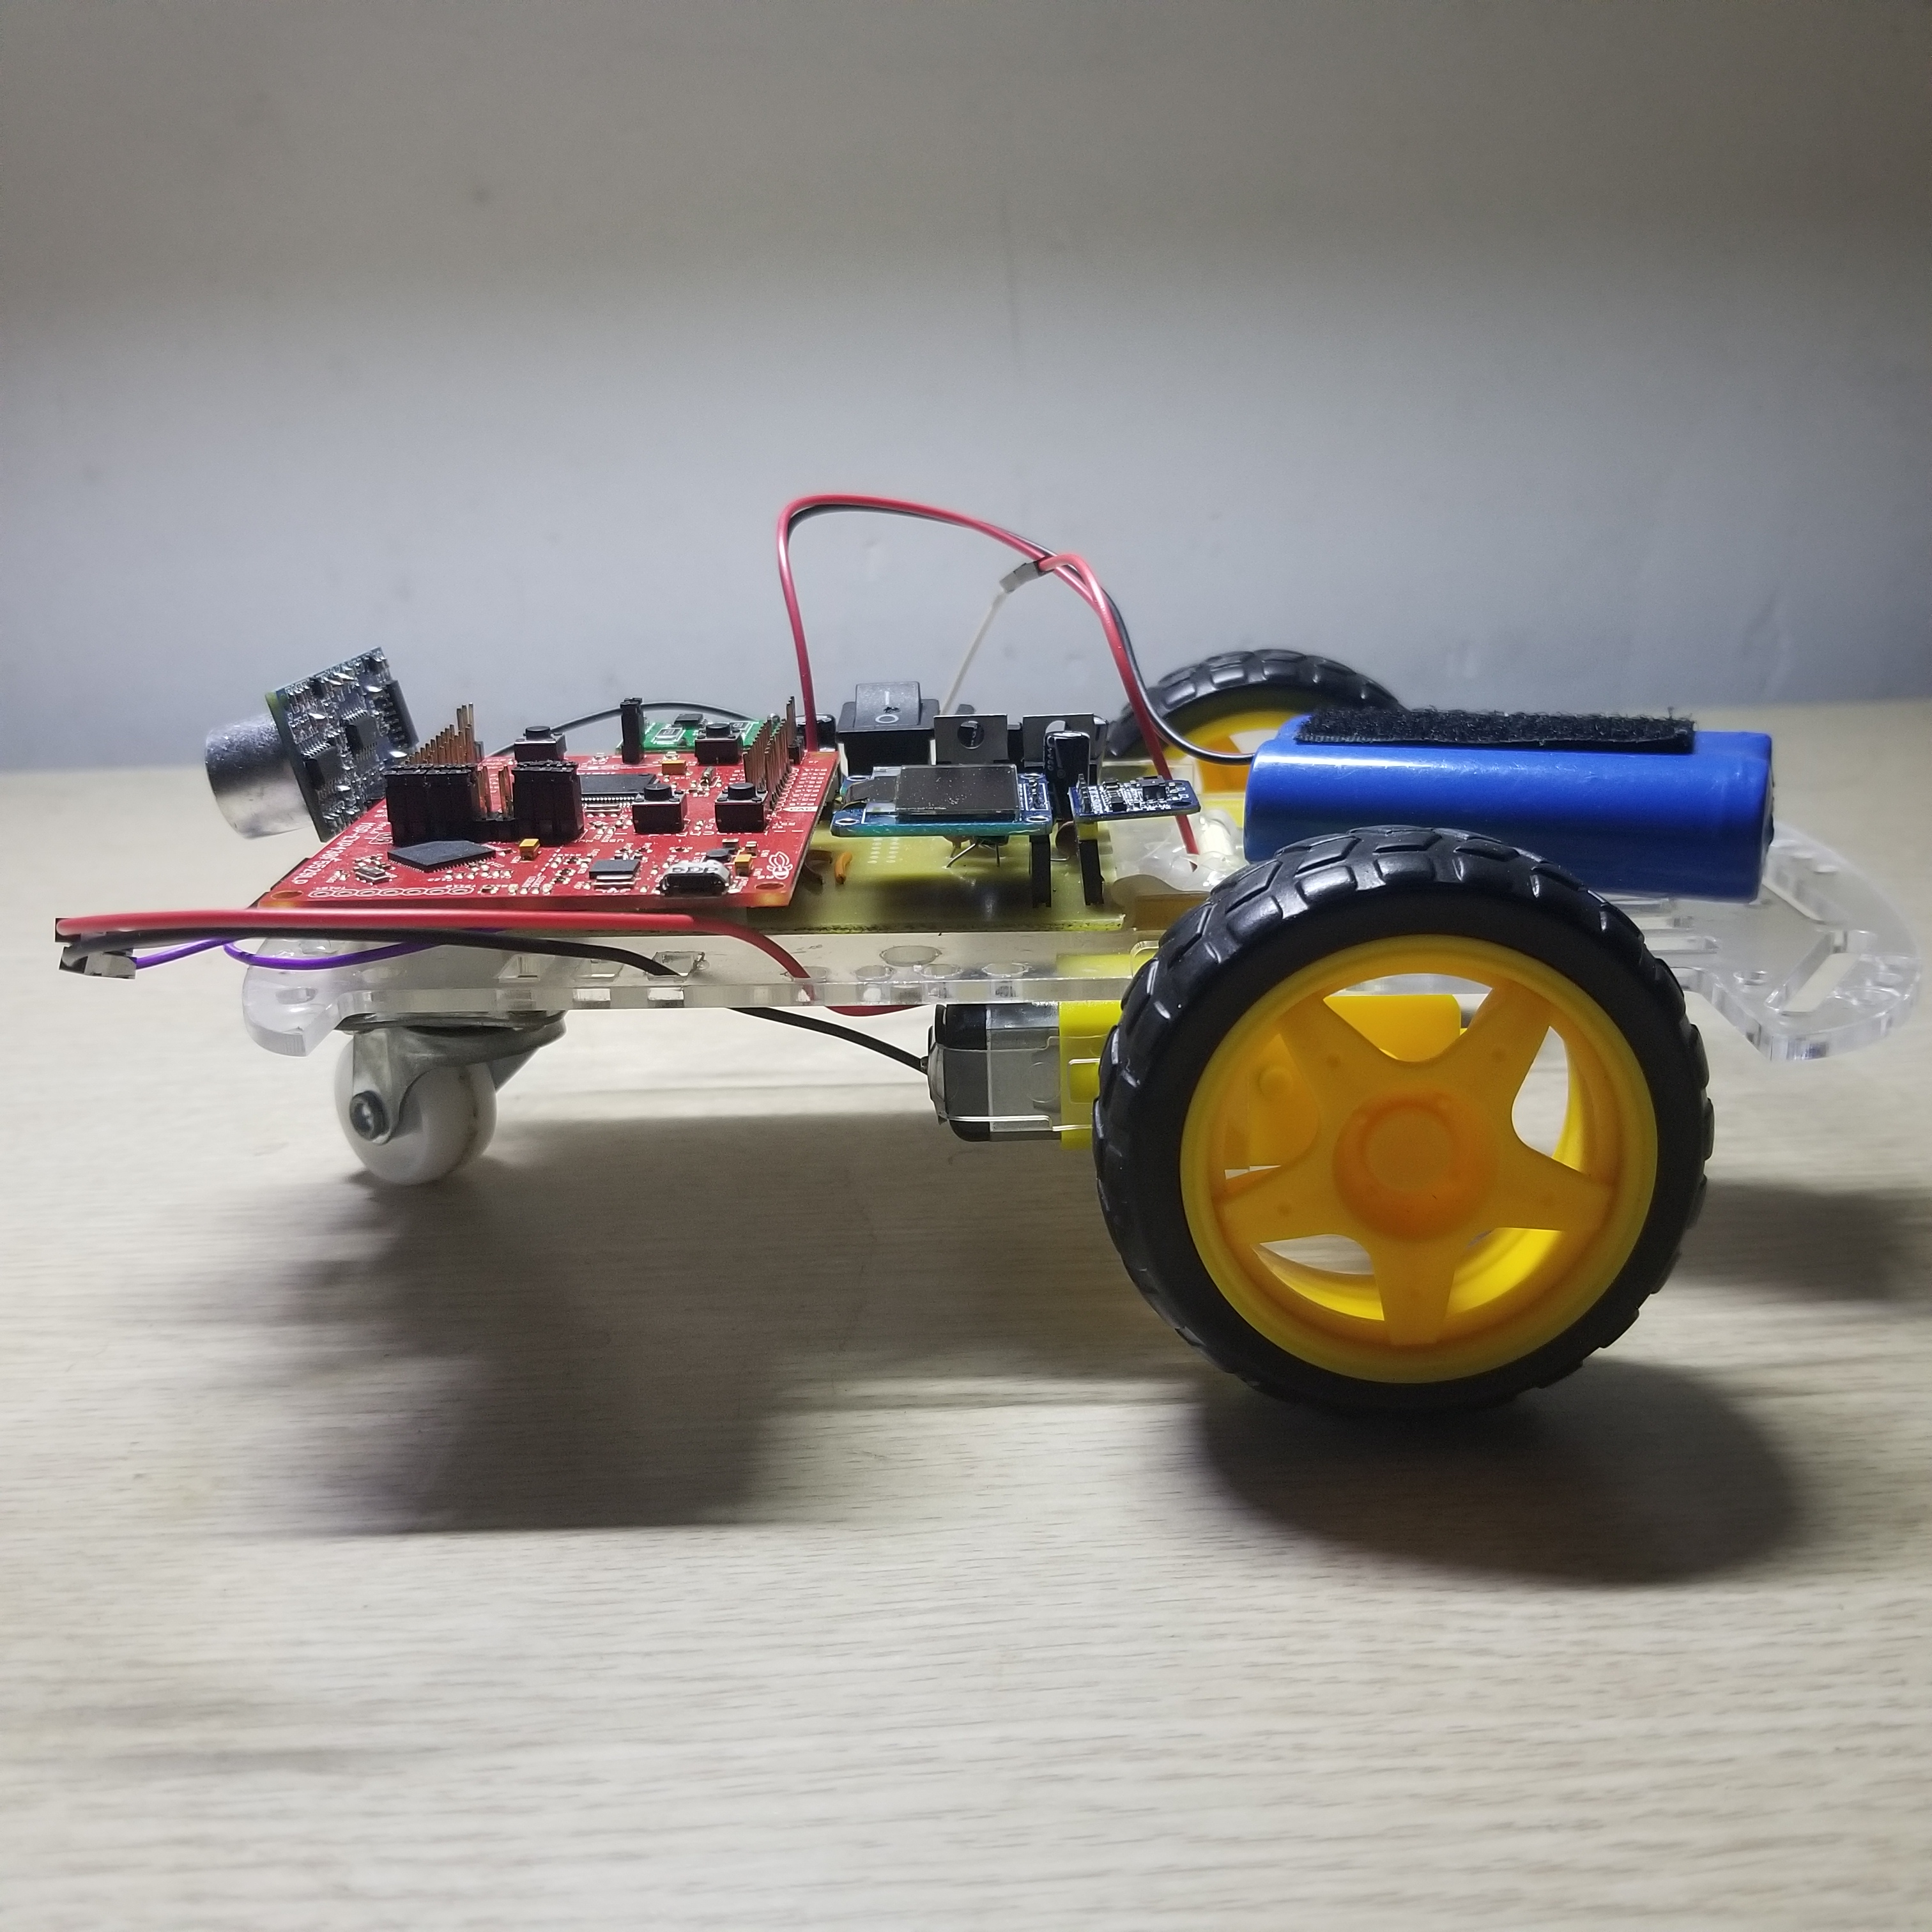
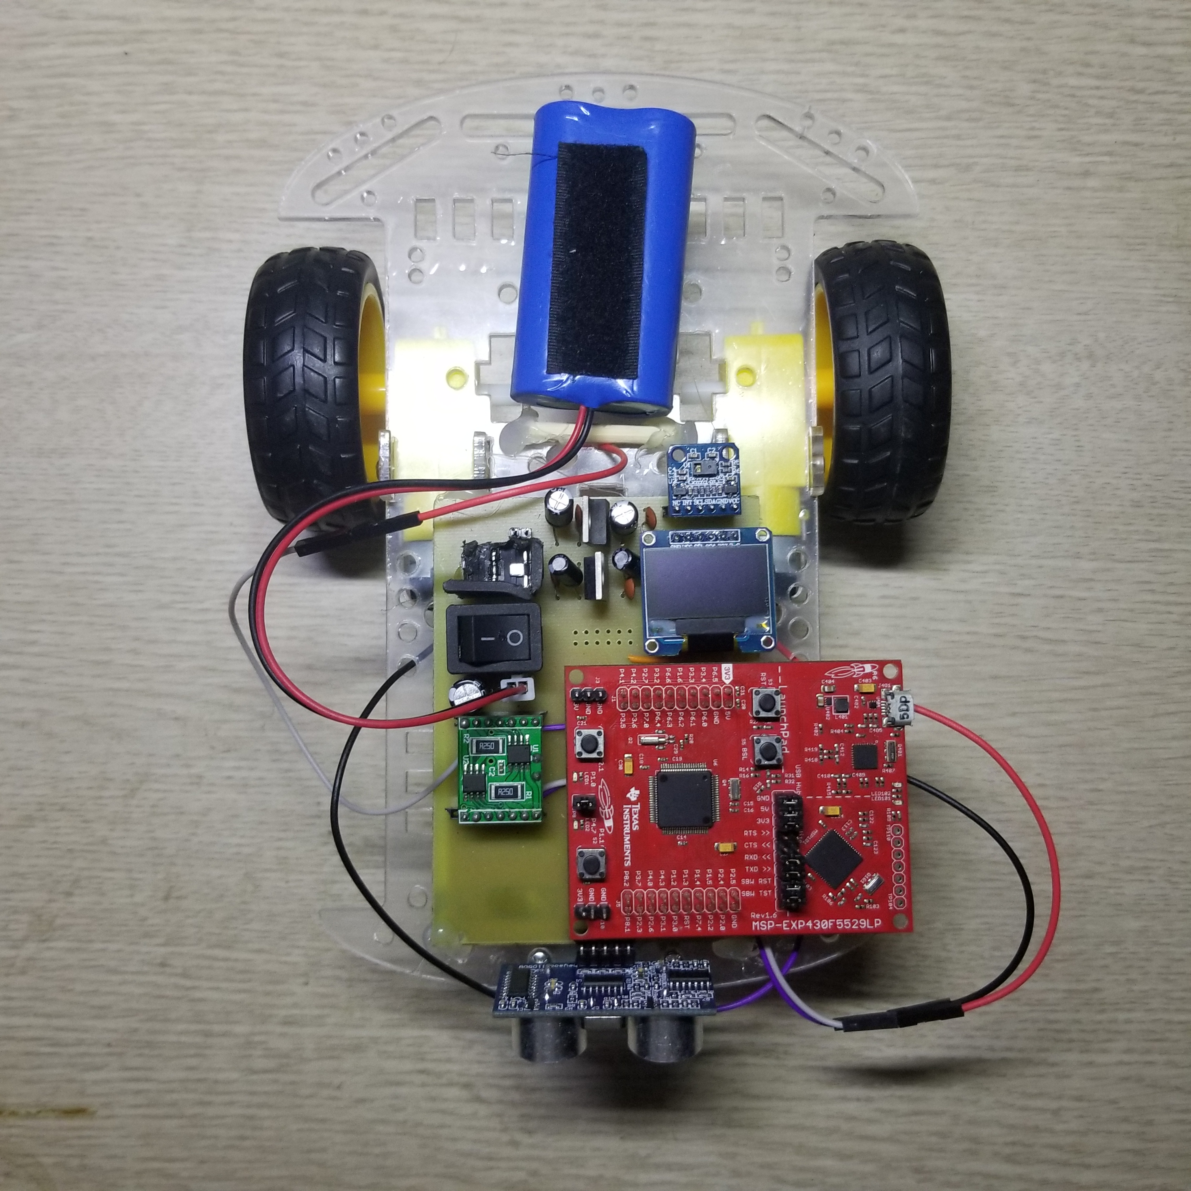
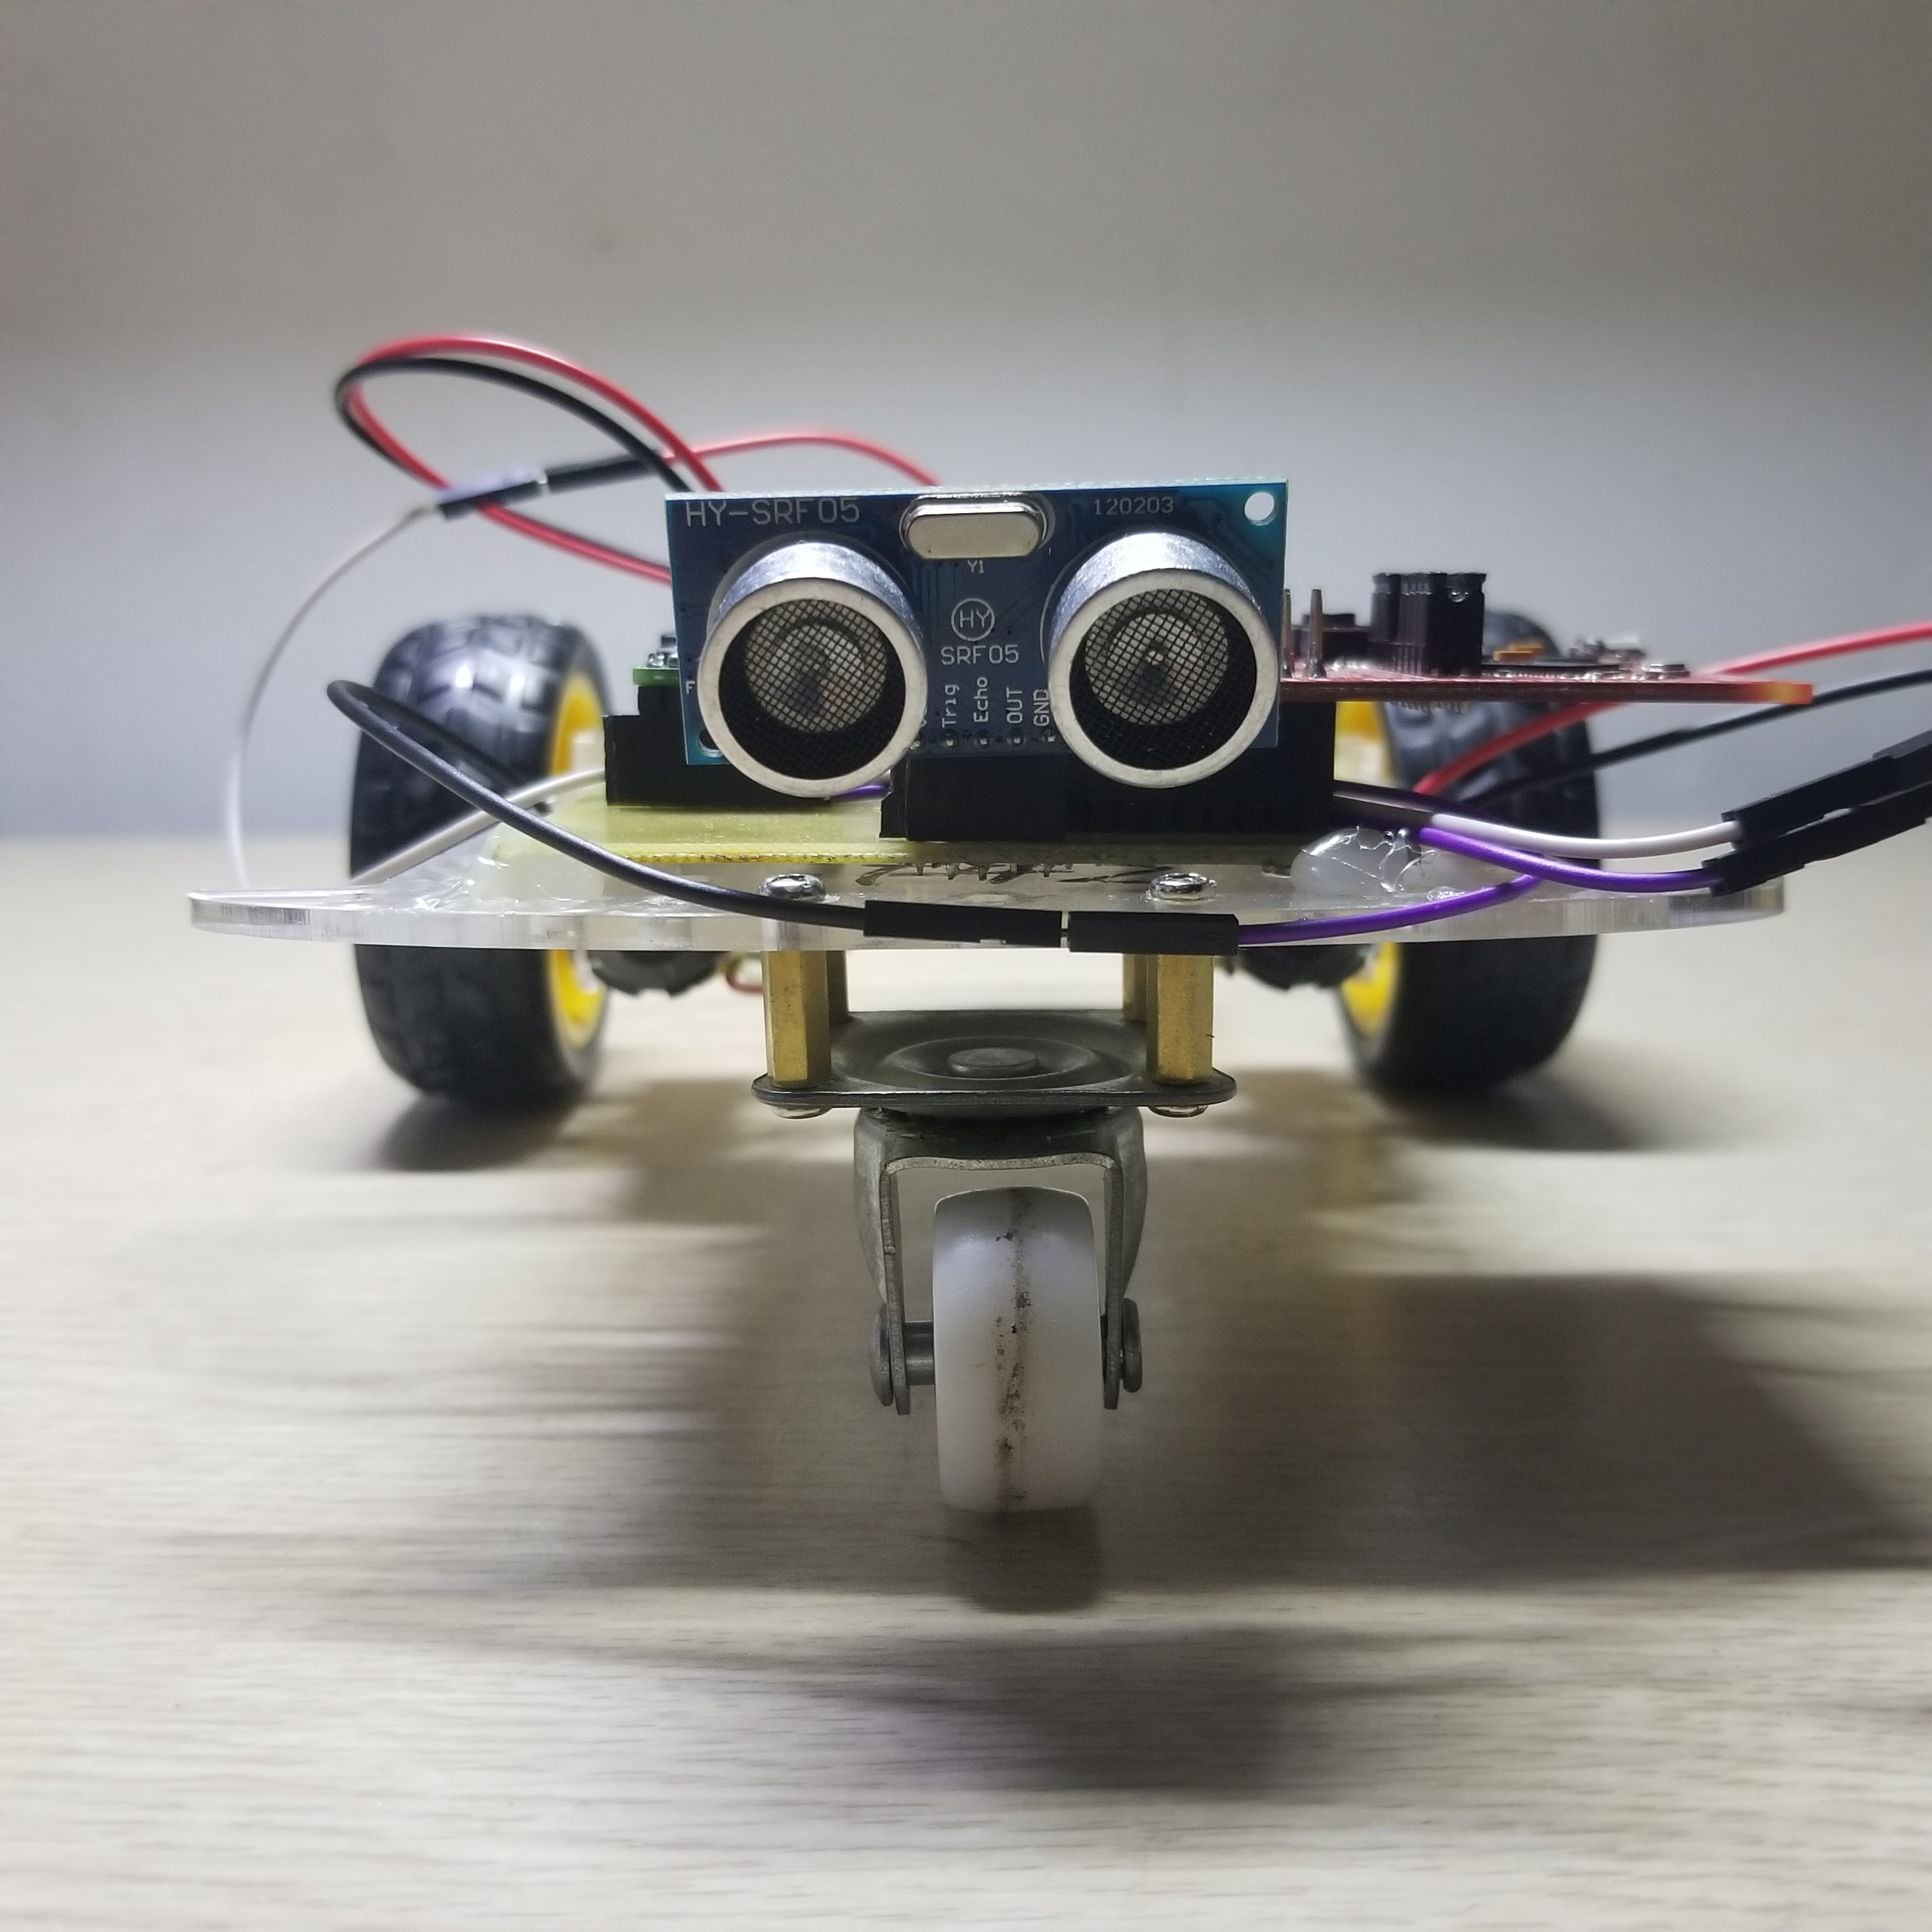
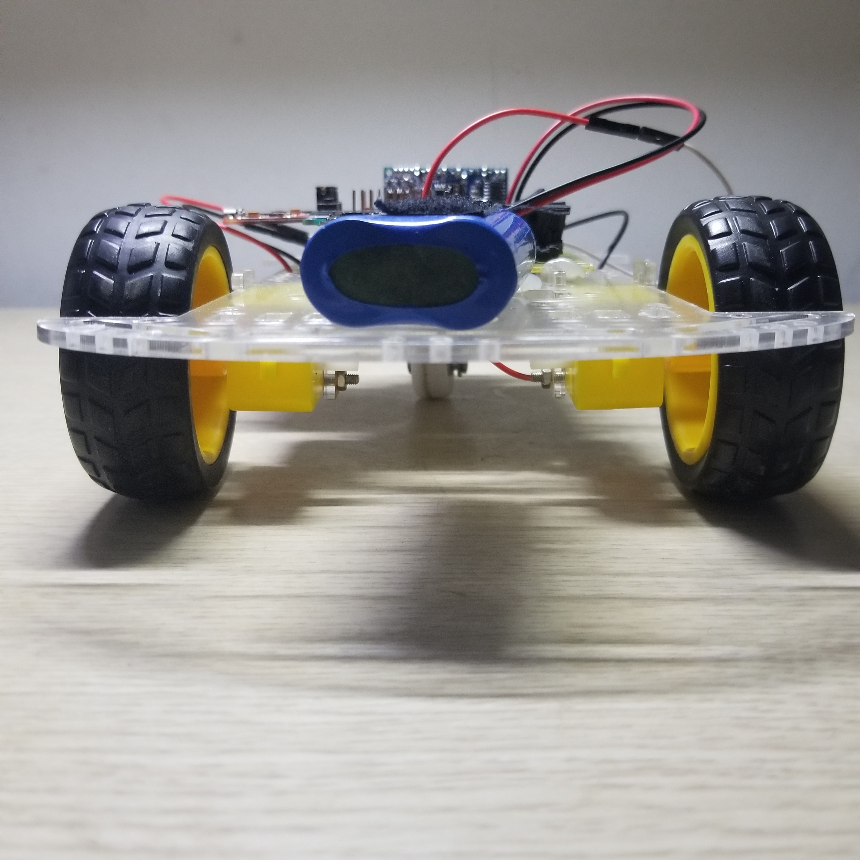
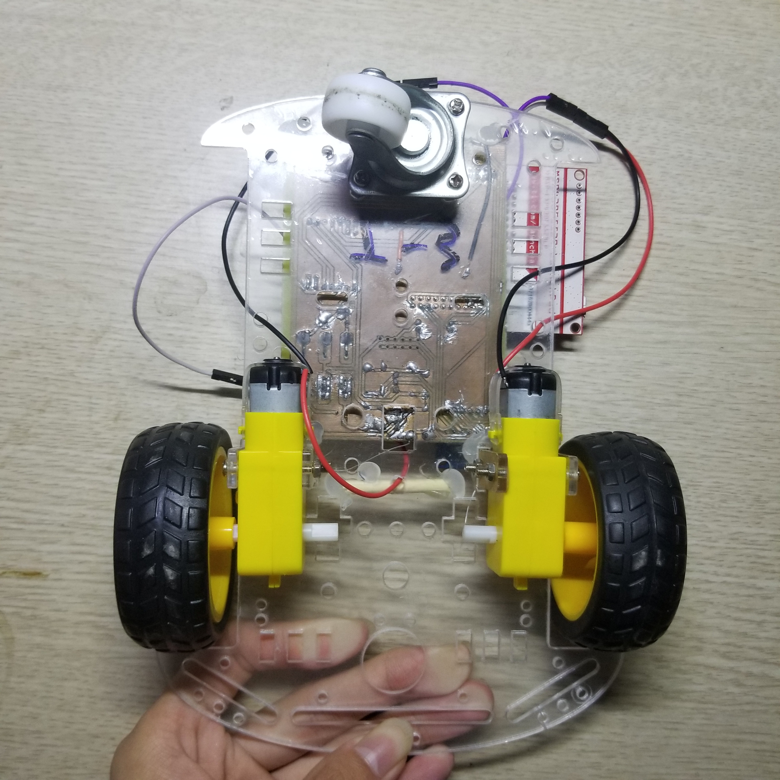
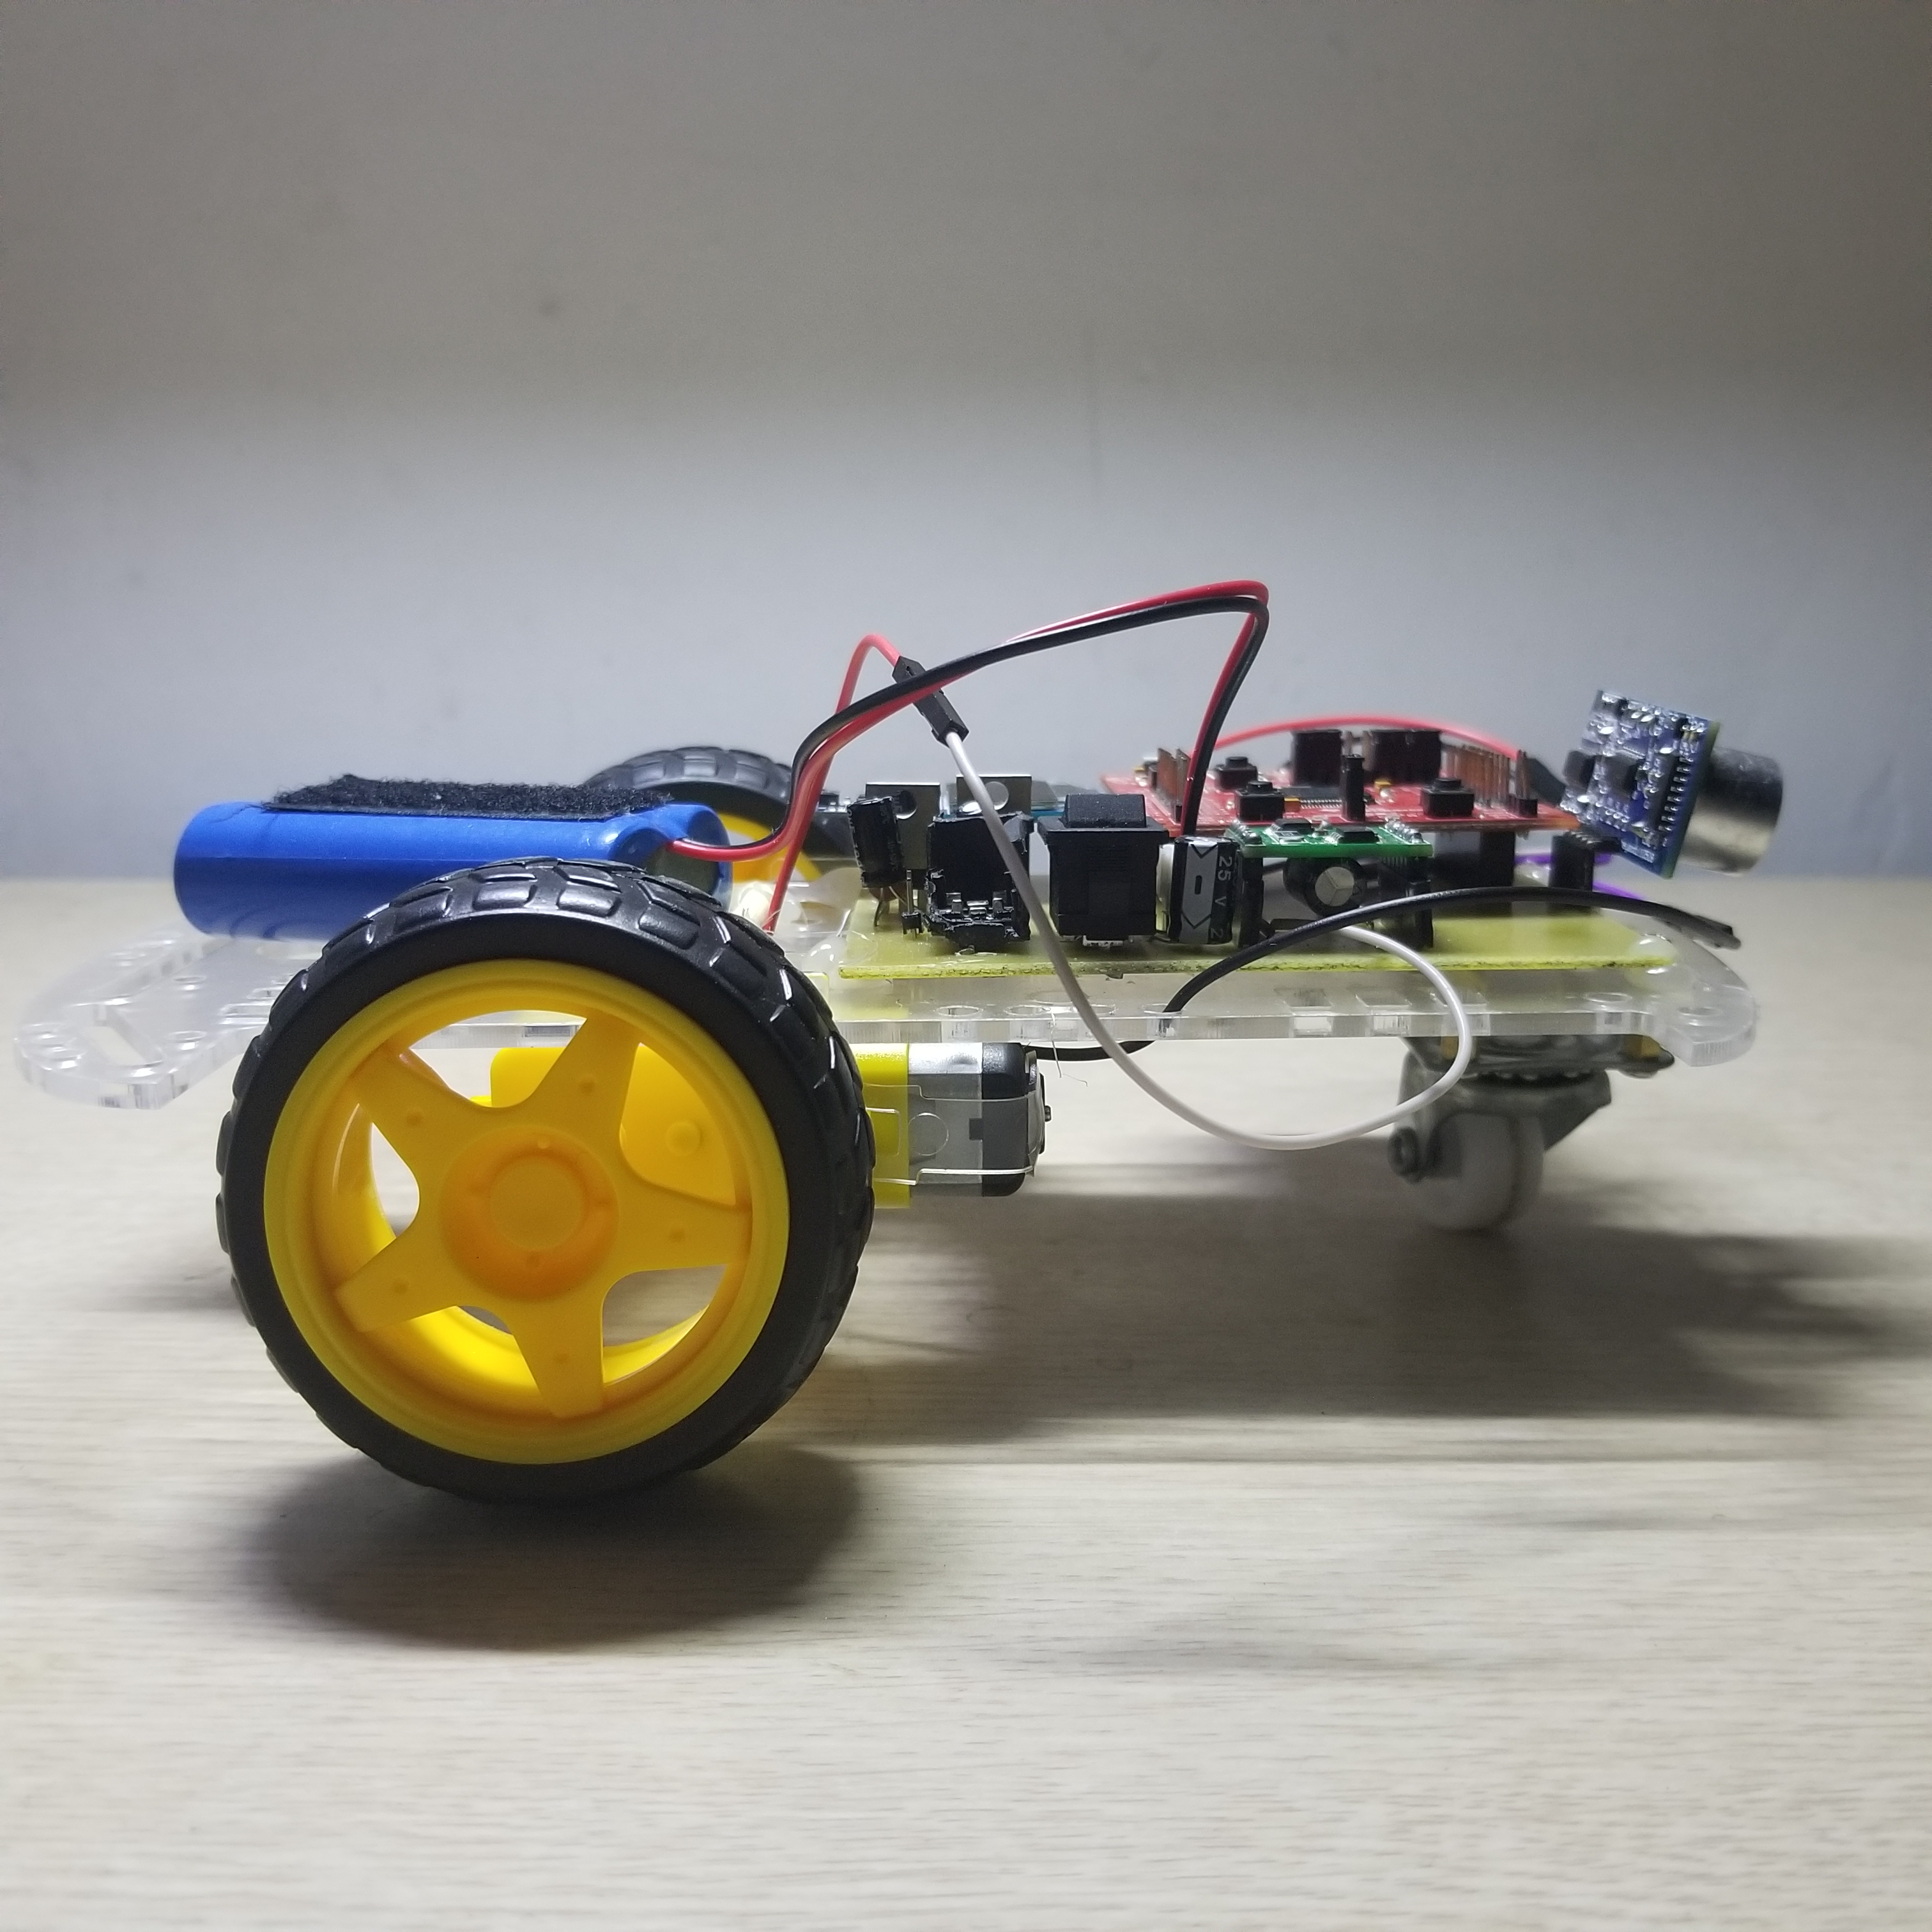
小车外观

Slide 3
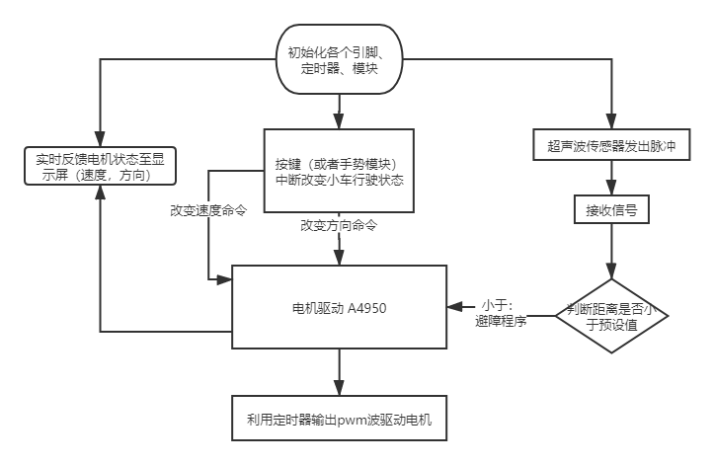
基本流程图

Slide 4
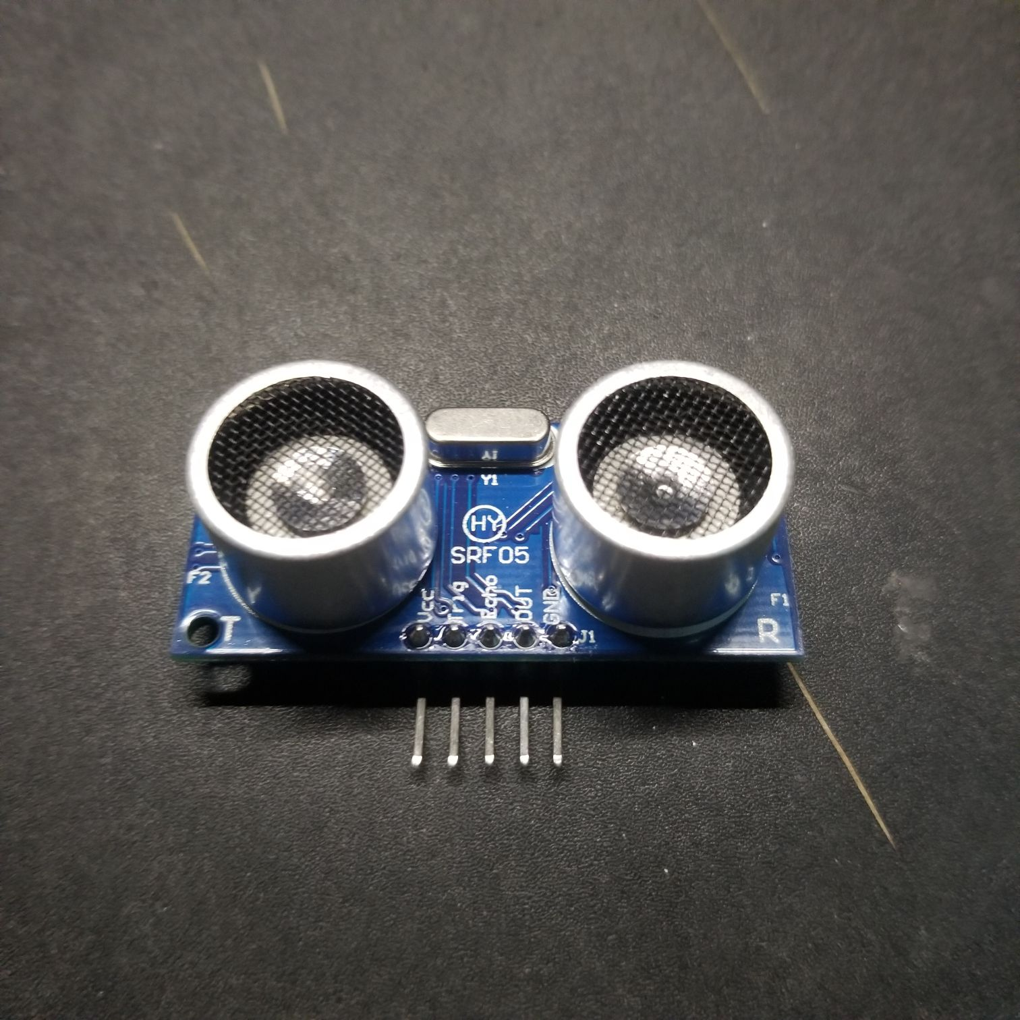
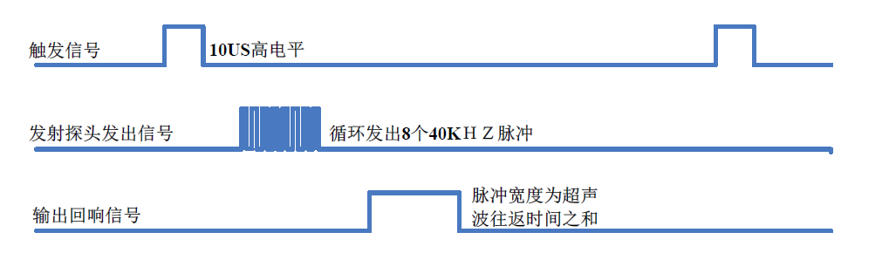
模块介绍
超声波传感器
工作原理：
单片机向超声波传感器 Tirg 端发送一个至少10us的高电平，启动超声波传感器模块发出8个40KHz的周期电平，然后单片机开始定时器中断。一旦检测到有回波信号则 Echo 端就会反馈回响信号。通过回响信号的脉冲宽度得出与其成正比的距离值。
时序图

Slide 5
引脚连接表
void HC_SR04Start() //开始超声发送
{
P1OUT |= BIT3;
delay_us(10); //至少持续10us的高电平
P1OUT &= ~BIT3;
}
void TimeGetInit() //初始化捕获模式
{
P1DIR &= ~BIT2;
P1SEL |= BIT2;
TA0CTL = TASSEL_2 + ID_0 + MC_2 + TACLR;
//SMCLK，连续计数模式
TA0CCTL1 = CM_1 + SCS + CAP + CCIE + CCIS_0;
//在上升沿捕获，同步捕获，捕获模式
}
Vcc | Trig | Echo | OUT | GND
Vcc | P1.3 | P1.2 | ~ | GND
程序
/*初始化*/
void HC_SR04Init()
{
P1DIR |= BIT3;
}

Slide 6
中断服务程序
#pragma vector = TIMER0_A1_VECTOR
__interrupt void TIMER0_A1_ISR(void) {
_DINT(); //关中断
if (times == 1) {
LastCCR1 = TA0CCR1; //记录下上次CCR2的值
TA0CCTL1 &= ~CM_1; //清上升沿捕获
TA0CCTL1 |= CM_2; //改为下降沿捕获
times++;
}
if (times == 0) {
if (i < 20) {
dat[i] = TA0CCR1 - LastCCR1; i++; }
if (i >= 20) {
for (i = 0; i < 20; i++) {
for (j = 0; j < 20 - i; j++) {
if (dat[j] > dat[j + 1]) {
t = dat[j]; dat[j] = dat[j + 1]; dat[j + 1] = t; }
}
}
t = 0;
for (i = 5; i < 15; i++) {
t = t + dat[i]; }
k = t / 10; i = 0; }
TA0CCTL1 &= ~CM_2; //清除下降沿触发
TA0CCTL1 |= CM_1; //变为上升沿触发
times++; //改变times的值
}
times &= 0x01; //times>1时清0
LPM0_EXIT; TA0CCTL1 &= ~CCIFG; _EINT(); }

Slide 7
数据处理
k = (int)((float)k * 0.01 * 340 / 2);
//距离为( 脉冲宽度 * 340 m/s ) / 2，smclk默认1MHz
dis[0] = k / 1000 + 48;
dis[1] = k % 1000 / 100 + 48;
dis[2] = 46;
dis[3] = k % 1000 % 100 / 10 + 48;
dis[4] = k % 1000 % 100 % 10 + 48;

Slide 8
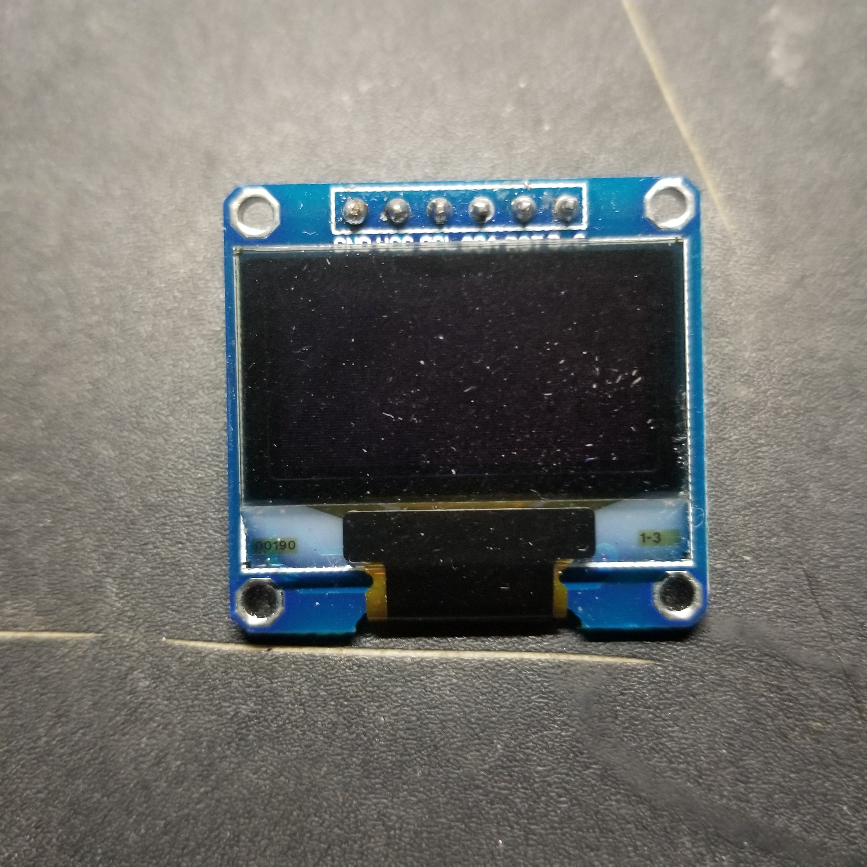
模块介绍
OLED显示模块
工作原理：
显示屏由SSD1306芯片驱动，支持SPI和I2C两种通信协议，此次使用I2C来控制显示屏。
引脚连接表
GND | VCC | SCL | SDA | RST | DC
GND | VCC | P4.3 | P4.0 | P3.7 | P8.2

Slide 9
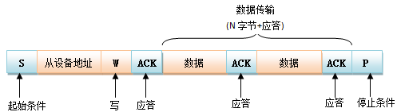
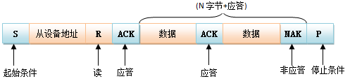
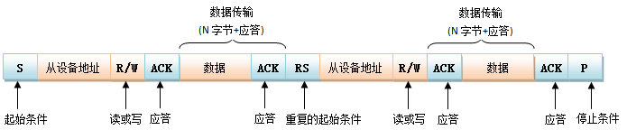
关于i2c

Slide 10
程序
void LCD_WrDat(unsigned char data) {
unsigned char i = 8;
LCD_DC_SET;
LCD_SCL_CLR;
while (i--) {
if (data & 0x80) {
LCD_SDA_SET; }
else {
LCD_SDA_CLR; }
LCD_SCL_SET;
asm("nop");
LCD_SCL_CLR;
data <<= 1;
}
}
void LCD_WrCmd(unsigned char cmd) {
unsigned char i = 8;
LCD_DC_CLR;
LCD_SCL_CLR;
while (i--) {
if (cmd & 0x80) {
LCD_SDA_SET; }
else {
LCD_SDA_CLR; }
LCD_SCL_SET;
LCD_SCL_CLR;
cmd <<= 1;
}
}

Slide 11
Ssd1306基础指令
1.页地址模式下设置列起始地址低位(Set Lower Column Start Address For Page Addressing Mode)(00h~0Fh)
2.页地址模式下设置列起始地址高位(Set Higher Column Start Address For Page Addressing Mode)(10h~1Fh)
3.设置内存地址模式(Set Memory Addressing Mode)(20h)
4.设置列地址(Set Column Address)(21h)
5.设置页地址(Set Page Address)(22h)
6.设置屏幕起始行(Set Display Start Line)(40h-7Fh)
7.设置对比度(Set Contrast Control for BANK0)(81h)
8.设置段重映射(Set Segment Re-map)(A0h/A1h)
9.全屏点亮(Entire Display ON)(A4h/A5h)
10.设置正常/反转显示(A6h/A7h)
11.设置复用率(A8h)
12.设置屏幕开启/关闭(AEh/AFh)
13.页地址模式下设置页起始地址
14.设置列输出扫描方向(Set COM Output Scan Direction)(C0h/C8h)
15.设置显示偏移(Set Display Offset)(D3h)
16.设置显示时钟分频值/震荡频率(Set Display Clock Divide Ration/Oscillator Frequency)(D5h)
17.设置预充电周期(Set Pre-charge Period)(D9h)
18.设置列引脚硬件配置(Set COM Pins Hardware Configuration)(DAh)
19.设置VCOMH反压值(Set VCOMH Deselect Level)(DBh)
20.空指令(NOP)(E3h)
21.读取状态寄存器(Status register Read)

Slide 12
初始化
void LCD_Set_Pos(unsigned char x, unsigned char y) {
LCD_WrCmd(0xb0 + y);
LCD_WrCmd(((x & 0xf0) >> 4) | 0x10);
LCD_WrCmd((x & 0x0f) | 0x01); }
void LCD_Fill(unsigned char bmp_data) {
unsigned char y, x;
for (y = 0; y < 8; y++) {
LCD_WrCmd(0xb0 + y);
LCD_WrCmd(0x01);
LCD_WrCmd(0x10);
for (x = 0; x < X_WIDTH; x++)
LCD_WrDat(bmp_data);
}
}
void LCD_CLS(void) {
unsigned char y, x;
for (y = 0; y < 8; y++) {
LCD_WrCmd(0xb0 + y);
LCD_WrCmd(0x01);
LCD_WrCmd(0x10);
for (x = 0; x < X_WIDTH; x++)
LCD_WrDat(0);
}
}

Slide 13
void LCD_Init(void) {
LCD_DC_SET_IO_INIT;
LCD_RST_SET_IO_INIT;
LCD_SDA_SET_IO_INIT;
LCD_SCL_SET_IO_INIT;
LCD_SCL_SET;
LCD_RST_CLR;
delay_ms(50);
LCD_RST_SET;
LCD_WrCmd(0xae);
LCD_WrCmd(0x00);
LCD_WrCmd(0x10);
LCD_WrCmd(0x40);
LCD_WrCmd(0x81);
LCD_WrCmd(0xcf);
LCD_WrCmd(0xa1);
LCD_WrCmd(0xc8);
LCD_WrCmd(0xa6);
LCD_WrCmd(0xa8);
LCD_WrCmd(0x3f);
LCD_WrCmd(0xd3);
LCD_WrCmd(0x00);
LCD_WrCmd(0xd5);
LCD_WrCmd(0x80);
LCD_WrCmd(0xd9);
LCD_WrCmd(0xf1);
LCD_WrCmd(0xda);
LCD_WrCmd(0x12);
LCD_WrCmd(0xdb);
LCD_WrCmd(0x40);
LCD_WrCmd(0x20);
LCD_WrCmd(0x02);
LCD_WrCmd(0x8d);
LCD_WrCmd(0x14);
LCD_WrCmd(0xa4);
LCD_WrCmd(0xa6);
LCD_WrCmd(0xaf);
LCD_Fill(0x00);
LCD_Set_Pos(0, 0); }

Slide 14
void LCD_P6x8Str(unsigned char x, unsigned char y, unsigned char ch[]) {
unsigned char c = 0, i = 0, j = 0;
while (ch[j] != '\0’) {
c = ch[j] - 32;
if (x > 126) {
x = 0;
y++;
}
LCD_Set_Pos(x, y);
for (i = 0; i < 6; i++)
LCD_WrDat(F6x8[c][i]);
x += 6;
j++;
}
}

Slide 15
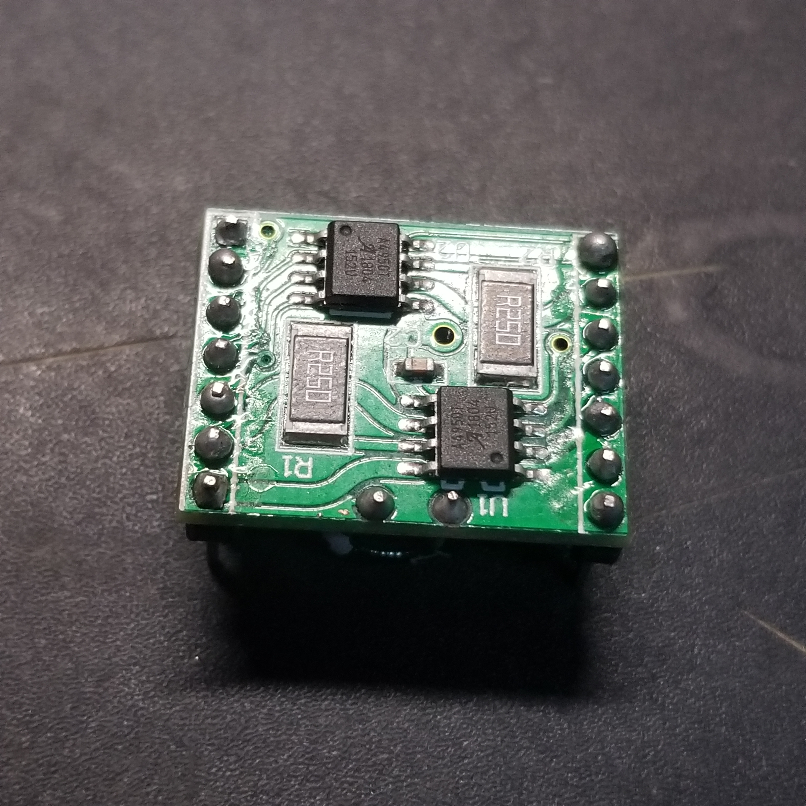
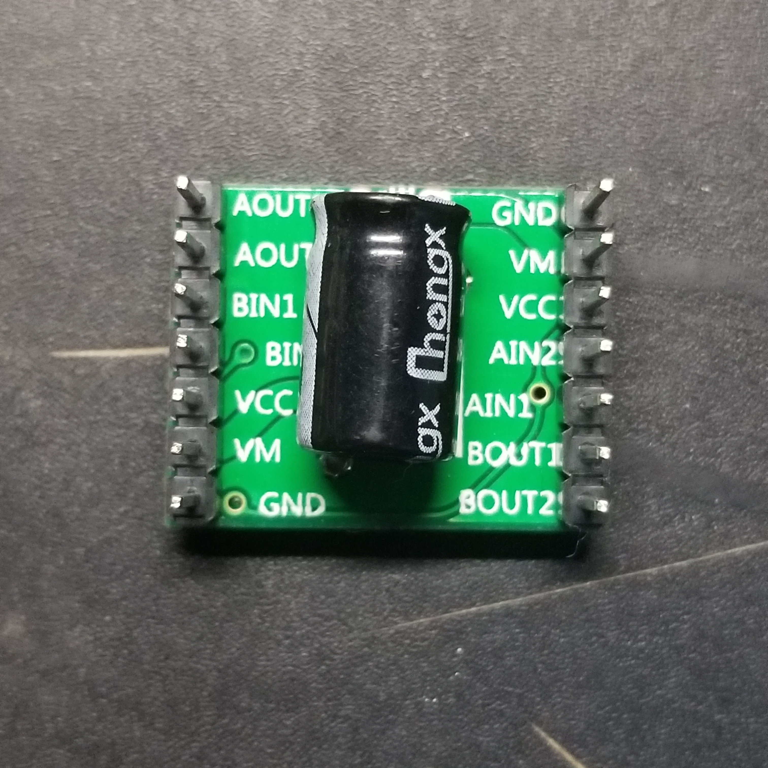
模块介绍
A4950电机驱动
工作原理：
分别给AIN1、 AIN2、 BIN1和BIN2接入 PWM波，当AIN1和AIN2接入 PWM波的占空比不相等时，AOUT1和AOUT2的输出就会有压差，即接入的电机两输入端即出现压差，从而使（直流）电机转动。（BIN1、BIN2同理）而AIN的占空比差越大，AOUT的压差就越大，电机转动的就越快。
引脚连接表
AOUT2 | AOUT1 | BIN1 | BIN2 | VCC | VM | GND
L2 | L1 | P2.4 | P2.5 | ~ | 7.4V | GND
GND | VM | VCC | AIN2 | AIN1 | BOUT1 | BOUT2
GND | ~ | 5V | P1.5 | P1.4 | R2 | R1
*A4950 电机驱动模块使用手册：模块上有两个VCC、VM、GND，建议都接，可以只接一个。

Slide 16
程序
void timer_init(void) {
P1DIR |= BIT4 + BIT5;
P1SEL |= BIT4 + BIT5;
P2DIR |= BIT4 + BIT5;
P2SEL |= BIT4 + BIT5;
TA0CTL = TASSEL_2 + MC_1 + TACLR;
TA2CTL = TASSEL_2 + MC_1 + TACLR;
//初始化，1MHz，
}
void TA2pwm_ctl(unsigned int R2, unsigned int R1) {
TA2CCR0 = 512 - 1;
TA2CCTL2 = OUTMOD_7;
TA2CCTL1 = OUTMOD_7;
TA2CCR2 = R2;
TA2CCR1 = R1;
}
void TA0pwm_ctl(unsigned int R4, unsigned int R3) {
TA0CCTL4 = OUTMOD_7;
TA0CCTL3 = OUTMOD_7;
TA0CCR0 = 512 - 1;
TA0CCR4 = R4;
TA0CCR3 = R3;
}

Slide 17
void upctl(float perc) {
perc = 100 - perc;
perc /= (float)100;
perc *= (float)512;
TA0pwm_ctl((int)perc, 511);
TA2pwm_ctl((int)perc, 511); }
void downctl(float perc) {
perc = 100 - perc;
perc /= (float)100;
perc *= (float)512;
TA0pwm_ctl(511, (int)perc);
TA2pwm_ctl(511, (int)perc); }
void turnlctl(float perc) {
perc = 100 - perc;
perc /= (float)100;
perc *= (float)512;
TA0pwm_ctl(511, (int)perc);
TA2pwm_ctl((int)perc, 511); }
void turnrctl(float perc) {
perc = 100 - perc;
perc /= (float)100;
perc *= (float)512;
TA2pwm_ctl(511, (int)perc);
TA0pwm_ctl((int)perc, 511); }
void stop(void) {
TA0pwm_ctl(0, 0);
TA2pwm_ctl(0, 0); }

Slide 18
/*驱动控制，结合按键中断*/
void carctl(unsigned int dirr, unsigned int speedd) {
switch (dirr) {
case 1:upctl(speedd * 20); break;
case 2:downctl(speedd * 20); break;
case 3:urnrctl(speedd * 20); break;
case 4:turnlctl(speedd * 20); break;
case 0:stop();break;
default: stop();
}
}
#pragma vector = PORT1_VECTOR __interrupt void Port_(void) {
_DINT(); key = P1IN & P1IFG;
delay_ms(2);
if (key == (P1IN & BIT1)) {
LCD_Fill(0x00);
switch (x) {
case 1: x = 2; dir[2] = 85;break;
case 2:x = 3; dir[2] = 68;break;
case 3: x = 4; dir[2] = 82;break;
case 4: x = 0; dir[2] = 73;break;
case 0: x = 1; dir[2] = 83;break;
default:dir[2] = 83; x = 0;
}
carctl(x, y);
}
_EINT(); P1IFG &= ~BIT1;
}
#pragma vector = PORT2_VECTOR
__interrupt void Port_2(void) {
_DINT(); key = P2IN & P2IFG;
delay_ms(2);
if (key == (P2IN & BIT1) {
LCD_Fill(0x00);
switch (y) {
case 1: sspeed[1] =50; y = 2; break;
case 2: sspeed[1] = 52; y = 3; break;
case 3: sspeed[1] = 54; y = 4; break;
case 4: sspeed[1] = 56; y = 5; break;
case 5: sspeed[0] =49; sspeed[1] =48;
y = 0; break;
case 0: sspeed[0] =48; sspeed[1] =48;
y = 1; break;
default: sspeed[0] =48; sspeed[1] =48;
y = 0;
}
carctl(x, y);
}
_EINT(); P2IFG &= ~BIT1;
}

Slide 19
结语

Slide 20
感谢观看

